Slide 1
COVID DATASET ANALYSIS

Slide 2
In this presentation you will be seeing what all can we do and what we can understand from the csv file ,on which all the following processes have been done and what all we can understand and extract.

Slide 3
First as in all things we will be reading the csv file
df=pd.read_csv(“covid_19_india.csv”)
Here we will be working on the “covid_19_india.csv” csv file
Just not to panic,csv file or comma separated values is a file in which all the values stored are separated by commas

Slide 4
Now to work on the datas , the functions or operations we use are contained
in modules and we will be accessing them by using the import statement.
Here we will be using numpy , pandas ,matplotlib ,sklearn and a few other
modules
Now we move onto reading datas , as in all cases there will be some false values or spelling mistakes and all. So to work on the data first we will be changing them to
the correct values

Slide 5
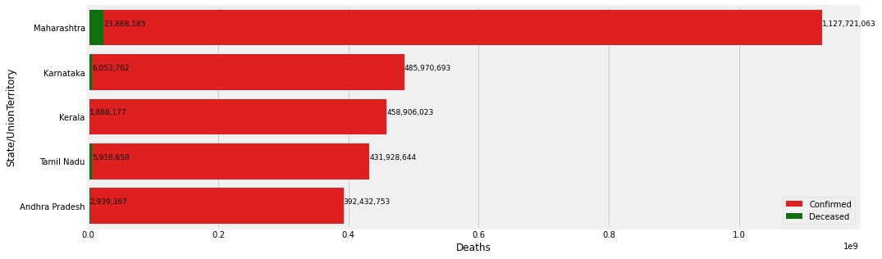
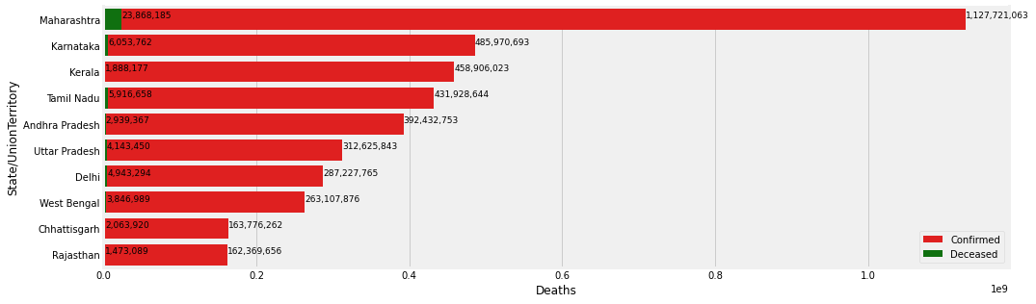
The file we are using is based on covid dataset , so first of all we will be seeing about the disease spread and the people recovered from the disease for a few states in india. Here , the first fig is about top 5 and the second is about top 10 states having maximum number of cases.

Slide 6
We will be seeeing the exponential model for the number of people affected and the deaths.
Now ,to put it simply lets take one couple,they have two kids and these kids get married and lets consider they have two children.Now the family started from 2 people ,in second phase 4 people and in third phase 8 people.
First phase Second phase Third phase
(1x2) 2 (2x2) 4 (4x2) 8
So here the family is growing,twice as the previous phase.
This is an exponential model where the growth is the twice the previous phase
So any model showing the same pattern of growth,we call it an exponenytial model.

Slide 7
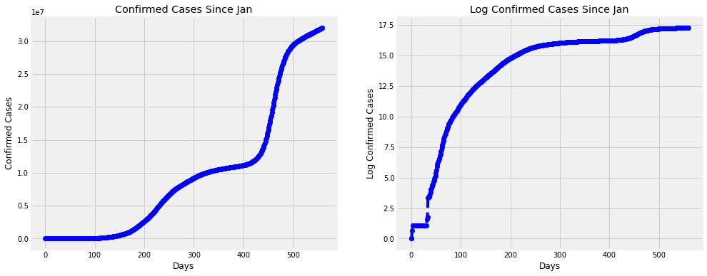
We will be seeing if the spread of the disease is exponential or not.
Mostly we will be checking a graph is exponential or not by taking the logarithmic
values as log is in the form of y=b raised to x. Here ,if b is a positive value it is an increasing and if x is same for all the log values , we can say it is an exponential model

Slide 8
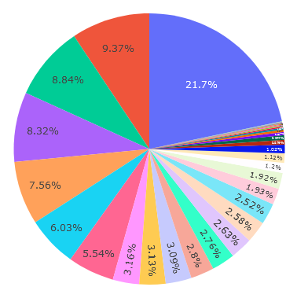
Below there is a pie chart showing the confirmed cases across India,
Blue : Maharashtra
Red : Karnataka
Green : Kerala
Violet : Tamil Nadu
Orange : Andhra Pradesh

Slide 9
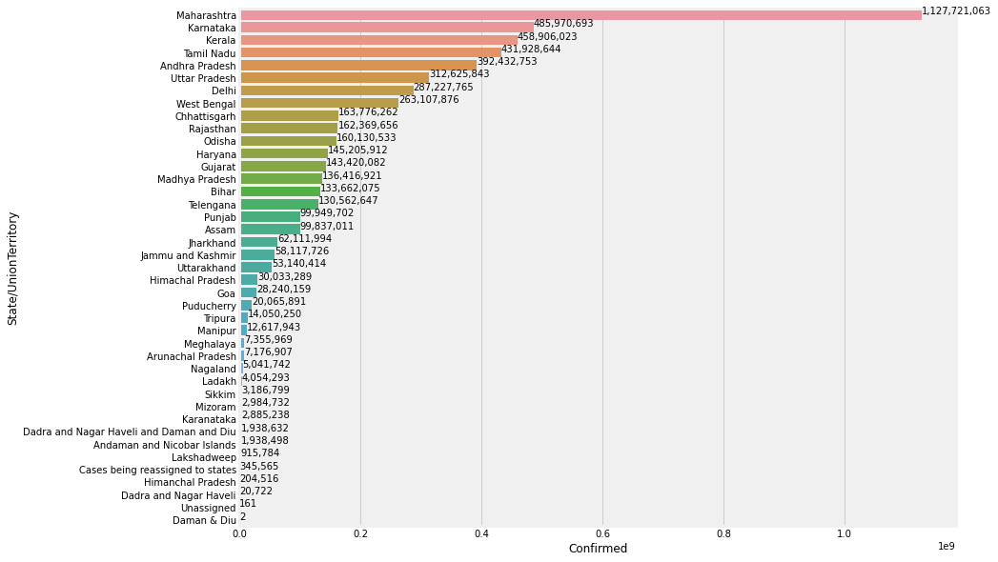
Below , a barplot also have been plotted showing the confirmed cases in all the states of India.

Slide 10
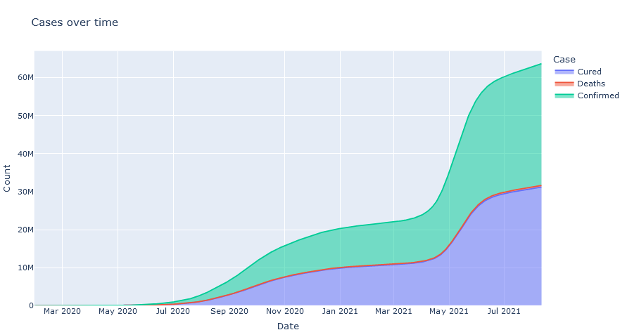
Now we will be seeing a graph where the confirmed,cured and deaths have been plotted to have a better idea of the disease plot.

Slide 11
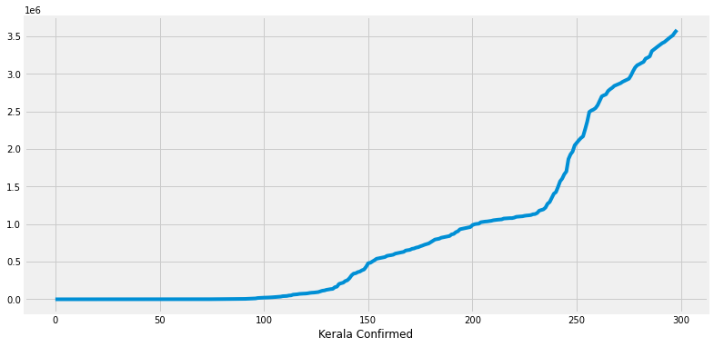
We have seen how the disease have spread in states across the India and India as a whole.
Since we are Keralites,now we will be seeing the disease condition in our
“God’s Own Country.”
In the graph in the first days,the disease spread was only gradually increasing but as time passed the graph has taken two tremendous leaps, it shows how the disease spreading has increased in a short period of time.

Slide 12
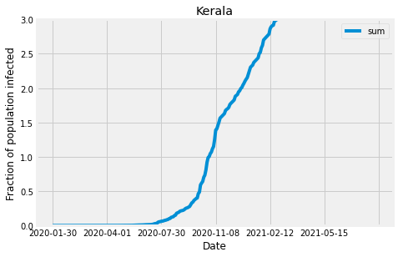
Here. there is a graph showing the population infected in Kerala, as in previous in first days it was slow then its increasing at a faster pace.Now we all know this is due to our own ignorance the condition has worsened.

Slide 13
Suppose you are given a bunch of number for example, 1 ,4, 7 ,11 ,15.We all will be thinking what is the relation and we know it increases by 4 and we caredict the next number as 15.
Similarly,here also we will try to predict the disease spread by finding a relation between them
Here we will be predicting them in two ways,mathematically our traditional method
and by machine learning where we will be entering a set of datas where machine will
be finding the relation and then predicting the disease spread on the basis of this
relation.

Slide 14
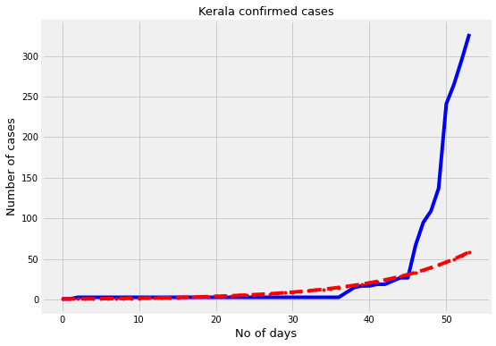
First, we will be seeing the predictions made graphically.
As we have discussed ,it is an eponential model ,we will be predictiing the values
on the basis of the relation y=x raised to b
Though we do it using the formula, the predictions made mathematically are less accurate than the one made by machine.
As we can see the predicted value in red is very
different from the actual value is in blue.

Slide 15
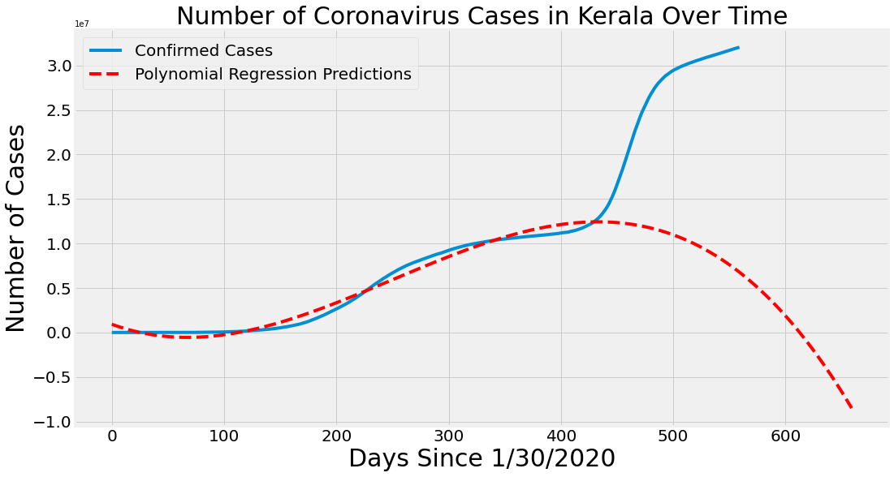
Secondly,we will be seeing the predictions made using machine
Here for the first upto 400 days ,
the values have been predicted correcly but after it increass again.
So here we can see why machine modelling is more accurate than mathematical modelling.

Slide 16
Hoping you have understood and thanking you for your patient listening and co-operation. Signing off: MEGHA B

Slide 17
THANK YOU

